Slide 1
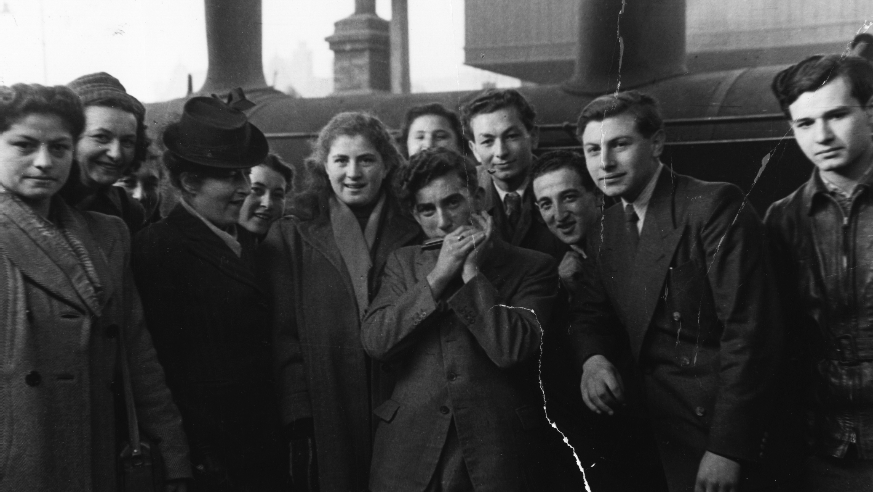
In Search of Better Days
Learning about Jewish Holocaust Survivors' Immigration Experiences through Primary Sources
Notes:
In today’s activity, we’ll be using primary sources to explore the stories of seven Jewish Holocaust survivors. We’ll learn about their lives after the Second World War ended, focusing on their immigration and integration experiences in Canada.
Image credit: Alex Dworkin Canadian Jewish Archives

Slide 2
Glossary
Primary Source
An original account of an event that was created at the same time as the event it describes or shows.
Secondary Source
An analysis, interpretation, or commentary on a primary source written by someone who did not experience the event it describes.
Survivor Testimony
A firsthand account from someone who lived through genocide.
Refugee
Someone who has been forced to flee their home country for many reasons, including war, persecution, and violence.
Notes:
Before we start, let’s go over some important terms that will come up throughout this activity. You can also look at the full glossary on the In Search of Better Days website if there are other words that you’re unfamiliar with.
Primary sources are one of our most important tools when learning about history because they were created by people who were present during the events they show or describe. Historians analyze and interpret primary sources to make conclusions about the past. They publish these conclusions as secondary sources like scholarly articles or books. During this activity, you’ll be analyzing primary sources to make your own interpretations – in other words, you’ll be acting as historians.
A survivor testimony is one example of a primary source. This type of primary source is very important for learning about the Holocaust because they provide firsthand accounts of people who lived through it. We’ll learn about other types of primary sources shortly.
This activity will teach us about some Jewish Holocaust survivors’ experiences as refugees. A refugee is someone who has been forced to flee their home for many reasons, including persecution and war. Refugees might have been persecuted because of things like race, religion, or nationality. For these reasons, refugees cannot return home, unlike an immigrant (someone who chooses to move to a new country).
How did Jewish people become refugees after the Second World War? Let’s learn a bit about the Holocaust to understand.
Image credit: City of Toronto Archives

Slide 3
About the Holocaust
The Holocaust was the state-sponsored persecution of European Jews by Nazi Germany and its collaborators.
The Holocaust took place between 1933 and 1945.
Over the course of the Holocaust, 6 million Jews were murdered.
The Holocaust took place across Europe.
Notes:
The Holocaust, also known as the Shoah, was the government-funded murder of European Jews by Nazi Germany and its collaborators between 1933 and 1945. Adolf Hitler, who became Chancellor of Germany in 1933, believed that the German people, or “Aryans” were superior and that all other threats, “non-Aryans,” needed to be exterminated so that Aryans could thrive. Over the course of the Holocaust, Jews were subject to harsh laws and social exclusion. They were later sent to either concentration camps where they had to partake in extremely hard labour, or extermination camps where they were killed immediately, mostly in gas chambers.
Over the course of the Holocaust, 6 million Jews were murdered. While European Jews were the main victims during the Holocaust, other victims of Nazi persecution included homosexual men, Jehovah’s witnesses, Soviet prisoners of war, Roma or Sinti (“Gypsy” people,) and those with disabilities. The activity focuses on Jewish survivors of the Holocaust.
The Holocaust took place across Europe, but the activity focuses on Jewish survivors from Poland, Germany, Czechoslovakia (now the Czech Republic and Slovakia,) Italy, and Ukraine.
Image credits: JIAS collection, Alex Dworkin Canadian Jewish Archives (header); United States Holocaust Memorial Museum

Slide 4
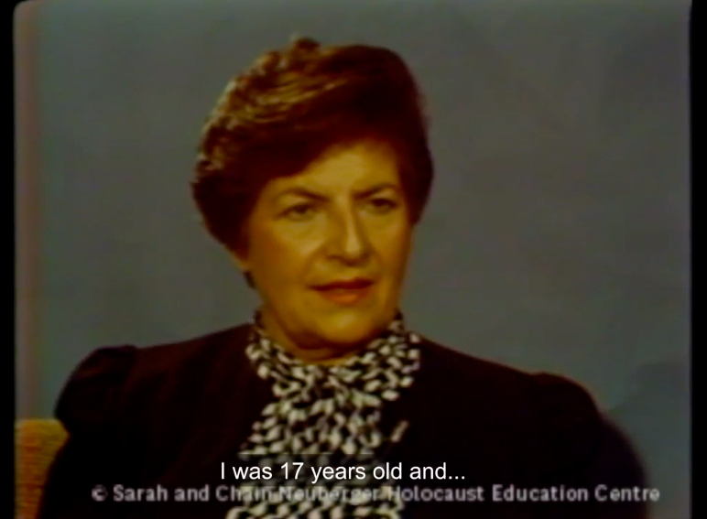
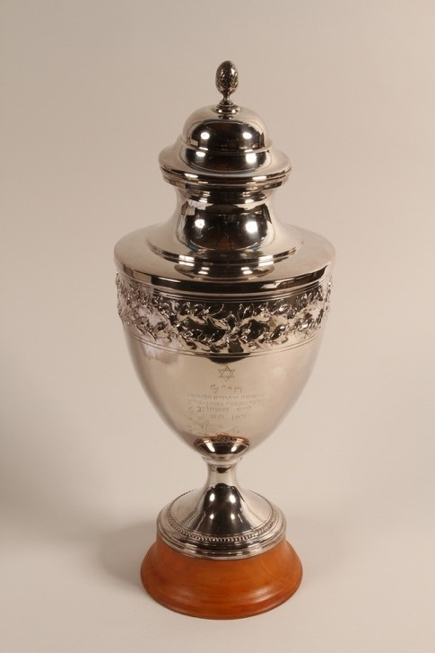
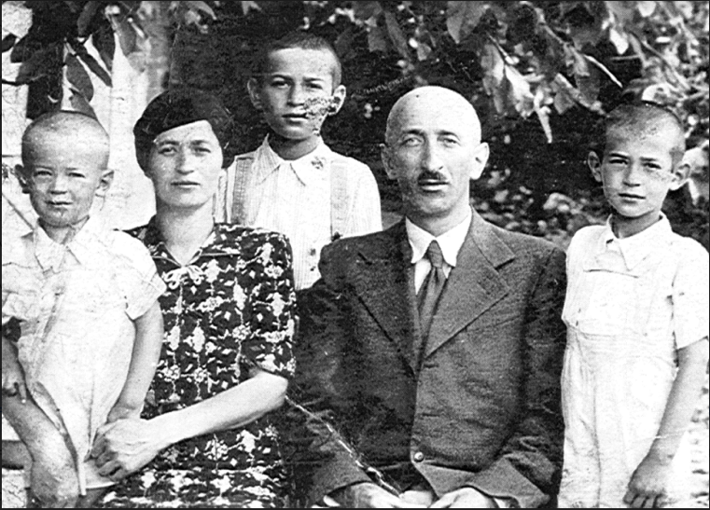
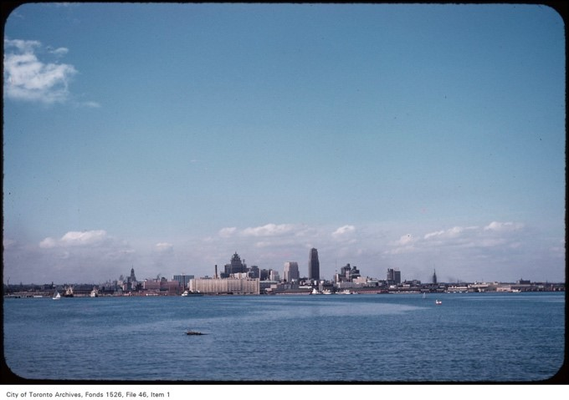
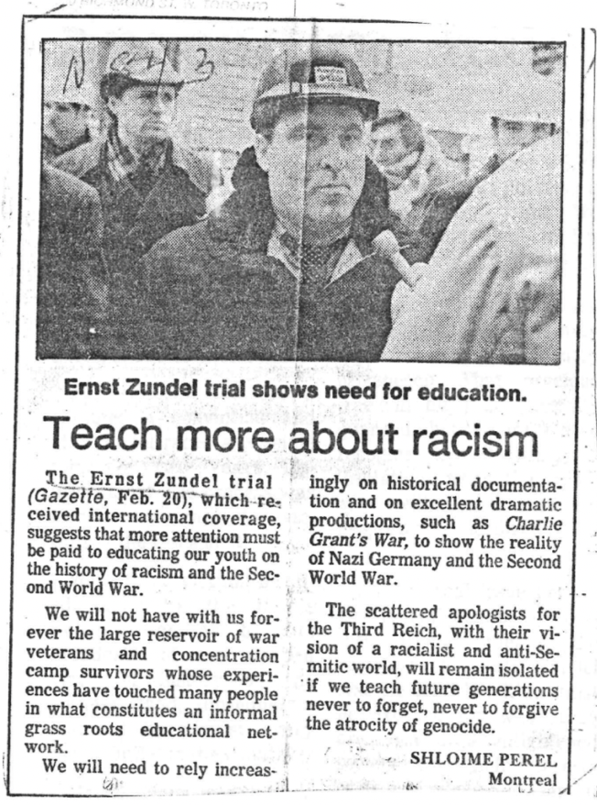
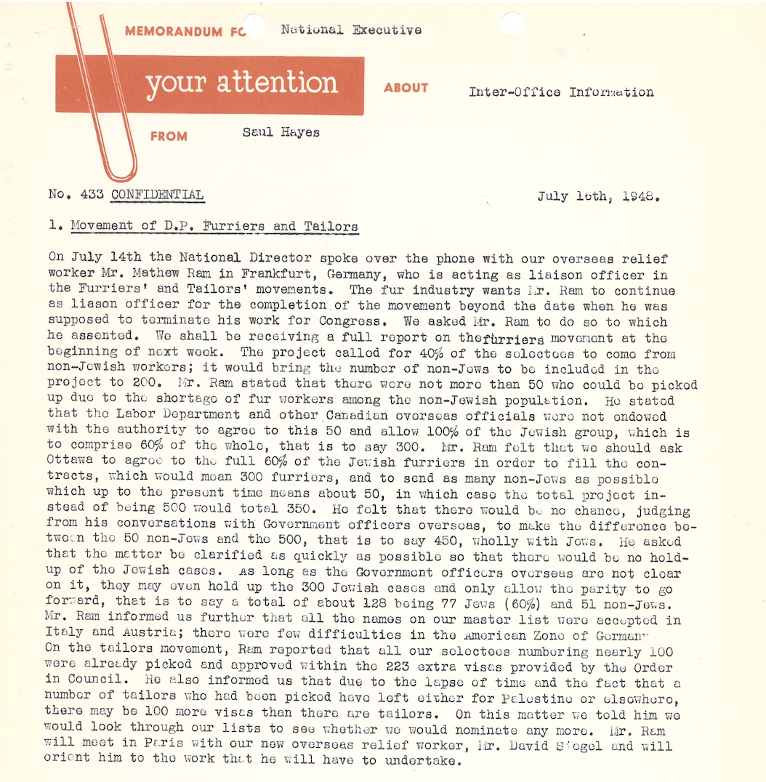
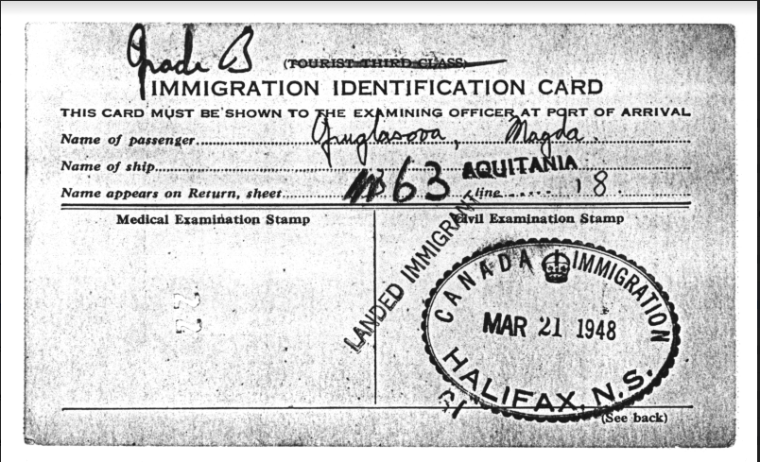
Types of Primary Sources
Survivor Testimonies
Photographs
Documents
Notes:
Let's talk about some of the types of primary sources that we will be looking at. Throughout the activity, we will be looking are three types of primary sources: oral testimonies, photographs, and documents.
The main type of primary source that we will be looking at today are oral testimonies. Oral histories are the collections of people’s memories and interpretations of their past experiences in their own words. The oral testimonies that you will see in the activity were recorded by the USC Shoah Foundation Institute. In 1994, the USC Shoah Foundation began building a collection of videotaped testimonies from Holocaust survivors and other witnesses. There are over 52,000 videotaped testimonies within their collection, collected in 56 countries and 32 languages. Today, you will be looking at small portions of the survivor’s testimony. As you’re watching and listening, look for clues that might indicate when the video was recorded and how the survivor feels.
The next type of primary source you’ll see in the activity are photographs. There are a wide range of photographs that capture different people and places. Other photographs capture objects that are related to the survivor’s testimony. You’ll notice that some of the photographs featured throughout the activity look a bit different. Some of them were taken in Europe in the early 1900s whereas others were taken in North America and are more modern. Think of ways that can help you to determine where a photograph was taken, how old it is, what is happening in the photograph, and what the photographer might have been thinking when they took the photograph.
The last type of primary source you’ll see in the activity are documents. You’ll see many different types of documents throughout the activity such as newspaper clippings, typed letters, and identification papers. Before you start the activity, think of ways that can help you to determine how old a document is, where it was written, who it was written by, and who it was written for. When looking at the documents, think about the tone, grammar, word choice, and style that the author uses and how this affects your interpretation of the document.
Image credits: JIAS collection, Alex Dworkin Canadian Jewish Archives (header); (top, from left to right) USC Shoah Foundation; City of Toronto Archives; United States Holocaust Memorial Museum; (bottom, from left to right) Alex Dworkin Canadian Jewish Archives; Sarah and Chaim Neuberger Holocaust Education Centre.

Slide 5
Immigration Policy Timeline
1936
1947
1962
Canada removes racially selective policies from the immigration system
F.C. Blair is put in charge of immigration
A new wave of immigration begins
1919
1939
1952
1976
Canada passes an Immigration Act that restricts who can move to the country
The MS St. Louis is turned away
The new Immigration Act still prevents "undesirables" from coming to Canada
Canada passes a new Immigration Act that promotes diversity
Notes:
Canada was not always the welcoming, multicultural society it considers itself today. Between the First and Second World Wars, the Canadian Government prevented certain people from moving to Canada. The Immigration Act was revised in 1919 to make it legal for the Canadian Government to stop people from moving to Canada because of their race, nationality, or religion.
Canadian immigration policies did not change to respond to increasing acts of antisemitism in Europe leading up to World War II. Instead, the people in charge of immigration to Canada, like immigration director F.C. Blair and Prime Minister William Lyon Mackenzie King, ensured that Jewish refugees would not be allowed into Canada. In 1939, Canada even refused to let a ship full of Jewish refugees dock in Canada. The Jewish refugees who were fleeing Nazi Germany on board the MS St. Louis were sent back to Europe, and many were killed by the Nazis. Throughout the Second World War, Canada only allowed 4000 Jewish refugees to enter – this compares to the 240,000 refugees who moved to the United States.
Motivated by labour shortages after the War, Canada began to allow more immigration in 1947. However, officials still wanted to restrict who could come to Canada. For example, the Immigration Act of 1952 allowed immigration officials to limit people from coming to Canada because of their nationality or customs. The barriers against Jews eventually fell away. Jewish Holocaust survivors were recruited from Displaced Persons Camps to fill needed jobs in the Canadian garment industry. Despite continued attempts to block immigration, thousands of Jewish Holocaust survivors moved to Canada between 1947 and 1961.
Canada’s immigration policy only began to transition into what we would recognize today after the 1960s. The policies that allowed racial discrimination were finally removed in 1962. Then, in 1976, Canada passed a new Immigration Act that promoted diversity in immigration and aimed to prevent discrimination.
Let’s explore the stories of seven Jewish Holocaust survivors who immigrated to Canada to understand how these policies affected real people.
Image credit: JIAS collection, Alex Dworkin Canadian Jewish Archives

Slide 6
Activity Instructions
1. In small groups, watch the videos and examine the objects within your assigned topic.
2. Complete a Survivor Testimony Discovery Worksheet and/or an Object Discovery Worksheet for 3 videos/objects.
3. Discuss our findings as a class.
Notes:
In small groups, you will be working together to discover the immigration stories of 7 Jewish Holocaust survivors. Each group will be assigned one of the first three sections of the In Search of Better Days website to analyze. As you watch videos and examine objects, you will work as a group to answer the questions on the worksheets provided to you. Remember to keep in mind what we learned today about the different types of primary sources.
Your groups will have about 20 minutes to complete these worksheets. After you’ve finished, we’ll come back together as a class to discuss what you have discovered. Then, we’ll learn more about how this connects to immigration today and what we can do to help newcomers to Canada.
Image credit: City of Toronto Archives

